Slide 1
Books Network

Slide 2
ID | Name | Email | Mobile
20120436 | Nourhan atef mouhamed galal | Nourhanatef12345@gmail.com | 01009832516
20120432 | Noura ahmed abd el wahab azzam | N_azzam93@yahoo.com | 01009788558
20120419 | Nada essam shehata ahmed | Nadaessam153@yahoo.com | 01028154704
20120510 | Bassma ezzat lofty abd elrahman | Bosbosa.94@gmail.com | 01009530055

Slide 3
Software Purpose
The purpose of this document is to make the E-book communication easy and more interactive between people.

Slide 4
Software Scope
The product described in this document is a system for books Network.
Books Network is therefore a social media but entirely for books.
We will focus our attention on the following aspects for books Network:
Read book.
View book.
Add and edit books in shelves
Show newsfeed.
Every person enter the website can perform any function above.
Every function above has more
Details we will explain it later.

Slide 5
Functional Requirements
Add book.
Remove book.
Search.
Add review.
Rate the book.
View review.
Show newsfeed.
Create group.
Non Functional Requirements
rate

Slide 6
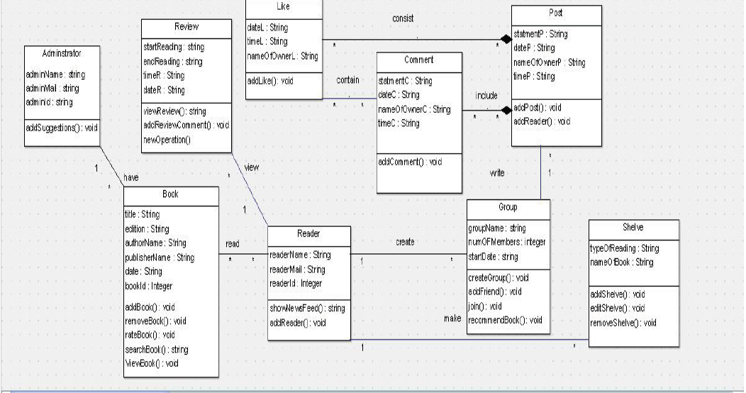
Class diagrams

Slide 7
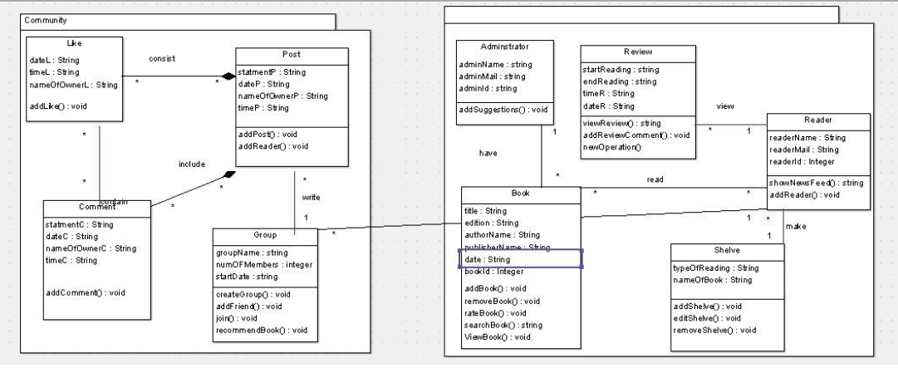
System Decomposition

Slide 8
challenges
* Most of this project we search to understand .
* We missed many lectures to complete this project.
* We face difficulty to connect to database.
*the time between each phase was not enough.

Slide 9
implementation

